Slide 1
SQL JOIN's

Slide 2
What is SQL JOIN’s?
In the expert level JOIN’S are more common SQL commands used in day to day life. JOIN’s are used to retrieving the records from multiple tables. SQL allows you to take JOIN’s on multiple tables from same database as well as different databases from same server.
Basically the tables are interrelated with each other using Primary & foreign key. So these keys are used in the JOIN’s to interlink two tables.

Slide 3
Why should we use JOIN’s?
Many times you are thinking “Why use SQL JOIN’s” as same task can be done using different queries. In the database queries are executed one by one & result of successive query can be use for next query. If we use the JOIN’s queries then instead of processing multiple queries SQL server process only single query which reduce the SQL server overhead. The main advantage of SQL JOIN’s is the improved performance. Also using multiple queries lead more data transfer from SQL server to application which reduces the performance

Slide 4
Types of SQL JOIN
1.INNER JOIN
2. OUTER JOIN
3.CROSS JOIN
4. SELF JOIN
1.EQUI/NON-EQUI JOIN
2.NATURAL JOIN

Slide 5
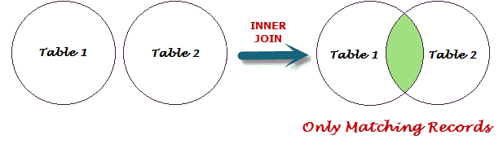
1.INNER JOIN
The INNER JOIN keyword selects all rows from both tables as long as there is a match between the columns in both tables (Table1 and Table2).
SELECT column_name(s) FROM Table1 INNER JOIN Table2 ON Table1.column_name=Table2.column_name;

Slide 6
LEFT OUTER JOIN
LEFT JOIN : The LEFT JOIN keyword returns all rows from the left table (Table1), with the matching rows in the right table (Table2). The result is NULL in the right side when there is no match.
RIGHT JOIN : The RIGHT JOIN keyword returns all rows from the right table (Table2),with the matching rows in the left table (Table1). The result is NULL in the left side when there is no match.
FULL JOIN: The FULL OUTER JOIN keyword returns all rows from the left table (Table1) and from the right table (Table2). The FULL OUTER JOIN keyword combines the result of both LEFT and RIGHT joins.

Slide 7
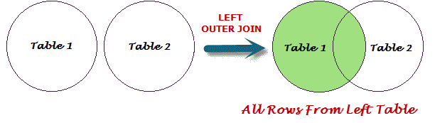
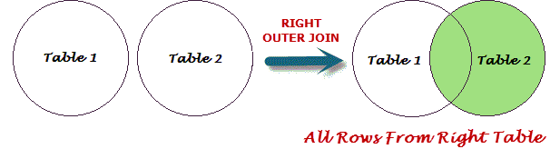
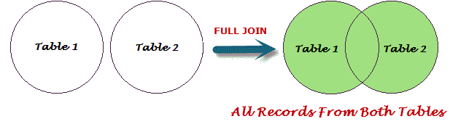
SELECT column_name(s) FROM Table1 LEFT JOIN Table2 ON Table1.column_name=Table2.column_name;
SELECT column_name(s) FROM Table1 RIGHT JOIN Table2 ON Table1.column_name=Table2.column_name;
SELECT column_name(s) FROM Table1 FULL JOIN Table2 ON Table1.column_name=Table2.column_name;

Slide 8
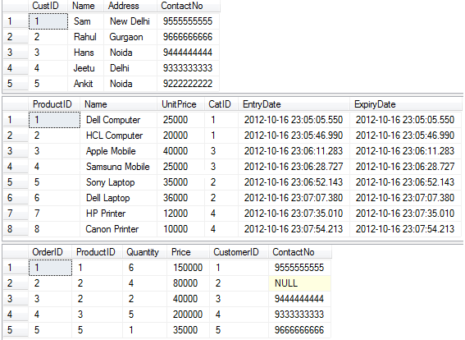
EXAMPLE

Slide 9
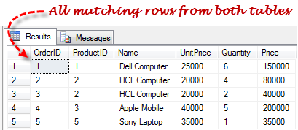
SELECT T2.OrderID, T1.ProductID, T1.Name, T1.UnitPrice, T2.Quantity, T2.Price FROM Product INNER JOIN Order ON T1.ProductID = T2.ProductID ORDER BY T2.OrderID
The result upon executing the above SQL INNER JOIN query:

Slide 10
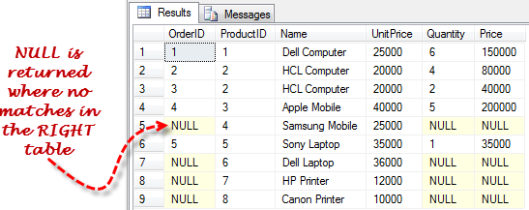
SELECT T2.OrderID AS OrderID, T1.ProductID, T1.Name, T1.UnitPrice, T2.Quantity AS Quantity, T2.Price FROM Product LEFT OUTER JOIN Order ON T1.ProductID = T2.ProductID ORDER BY T1.ProductID

Slide 11
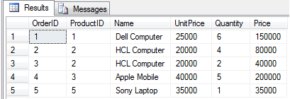
SELECT T2.OrderID AS OrderID, T1.ProductID, T1.Name, T1.UnitPrice, T2.Quantity AS Quantity, T2.Price FROM Product RIGHT OUTER JOIN Order ONT1.ProductID = T2.ProductID ORDER BY T1.ProductID

Slide 12
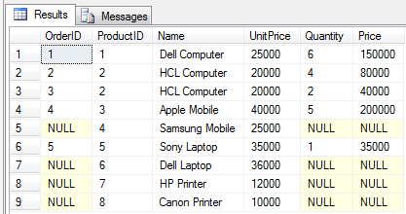
SELECT T2.OrderID AS OrderID, T1.ProductID, T1.Name, T1.UnitPrice, T2.Quantity AS Quantity, T2.Price ASPrice FROM Product FULL OUTER JOIN Order ON T1.ProductID = T2.ProductID ORDER BY T1.ProductID

Slide 13
CROSS JOIN(Cartesian Product)
A Cartesian product is formed when:
A join condition is omitted
A join condition is invalid
All rows in the first table are joined to all rows in the second table
To avoid a Cartesian product, always include a valid join condition in a WHERE clause.

Slide 14

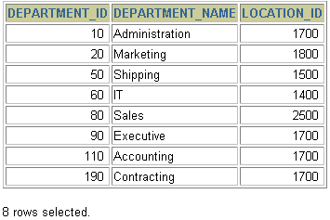

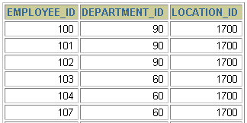
Generating a Cartesian Product
EMPLOYEES (20 rows)
DEPARTMENTS (8 rows)
…
Cartesian product: 20x8=160 rows
…

Slide 15
Joining Tables Using Oracle Syntax
Use a join to query data from more than one table.
Write the join condition in the WHERE clause.
Prefix the column name with the table nAme when the same column name appears in more than one table.
SELECT table1.column, table2.column
FROM table1, table2
WHERE table1.column1 = table2.column2;

Slide 16
SELF JOIN
A self-join is a query in which a table is joined (compared) to itself. Self-joins are used to compare values in a column with other values in the same column in the same table. One practical use for self-joins: obtaining running counts and running totals in an SQL query.

Slide 17
employee_name | employee_location
Joe | New York
Sunil | India
Alex | Russia
Albert | Canada
Jack | New York
Now, suppose we want to find out which employees are from the same location as the employee named Joe.

Slide 18
First Method
SELECT employee_name FROM employee WHERE
employee_location in
( SELECT employee_location FROM
employee WHERE employee_name = "Joe")
this is called Nested Query
Second Method
SELECT e1.employee_name FROM employee e1, employee e2
WHERE e1.employee_location = e2.employee_location
AND e2.employee_name="Joe";
This is self join

